Slide 1
Week 13 Updates

Slide 2
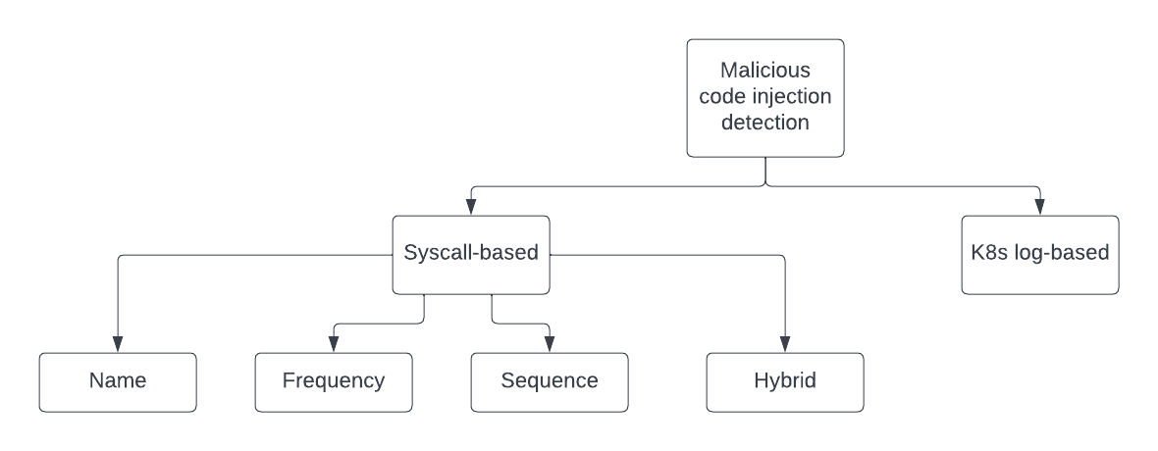
Classification
Ex: RBAC
Ex: SQLi
Ex: XSS
Ex: CSRF

Slide 3
Proposals for efficiency and scalability
Divide each service into separate microservices (with individual detection model)
Pros:
More scalable
More efficient (parallelism)
Cons:
Higher initial setup cost

Slide 4
Graphs

Slide 5
Graphs

Slide 6
Graphs

